Slide 1
Cardiovascular disease in the elderly
Professor of the Department internal diseases Liskova Yu.V.

Slide 2
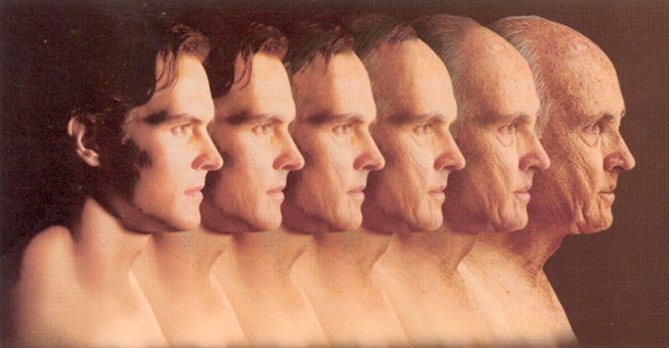
Aging process

Slide 3
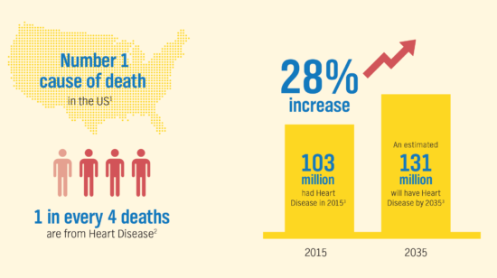

Slide 4
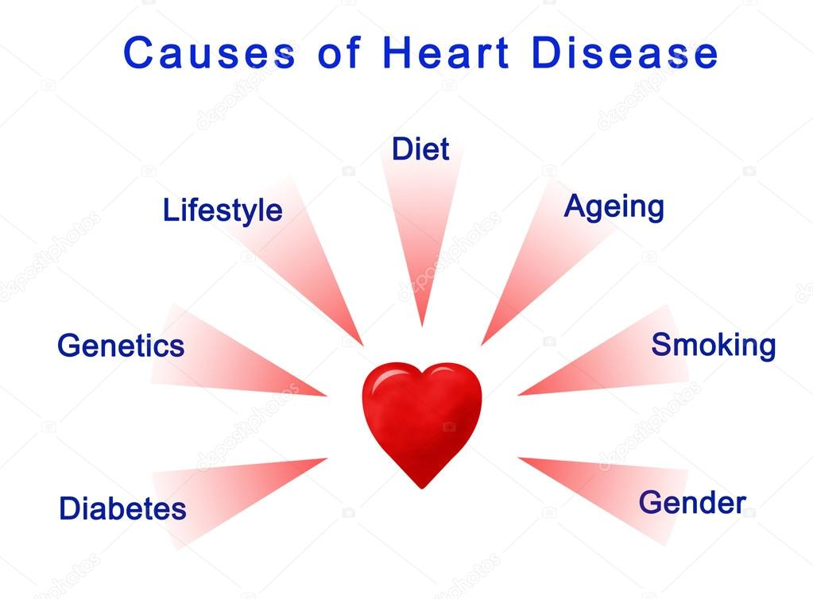

Slide 5
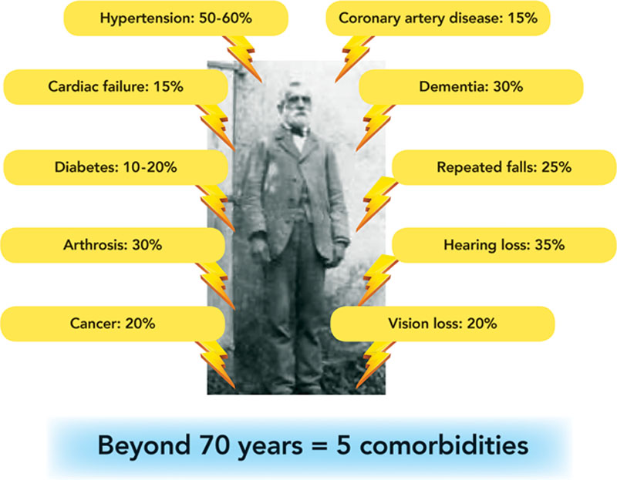

Slide 7
The Intersection Between Aging and Cardiovascular Disease
The average lifespan of humans is increasing, and with it the percentage of people entering the 65 and older age group is growing rapidly and will continue to do so in the next 20 years.
Within this age group, cardiovascular disease will remain the leading cause of death, and the cost associated with treatment will continue to increase.
Aging is an inevitable part of life and unfortunately poses the largest risk factor for cardiovascular disease.
Although numerous studies in the cardiovascular field have considered both young and aged humans, there are still many unanswered questions as to how the genetic pathways that regulate aging in model organisms influence cardiovascular aging.
Likewise, in the molecular biology of aging field, few studies fully assess the role of these aging pathways in cardiovascular health.

Slide 9
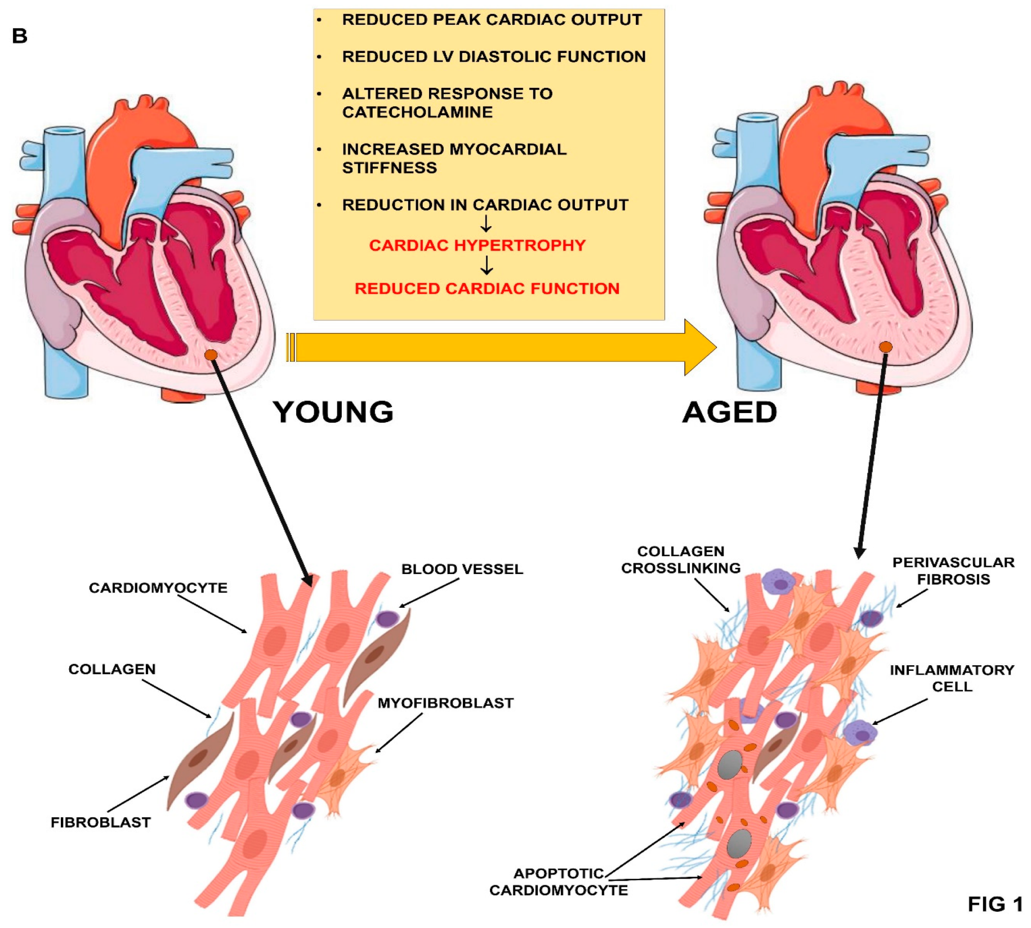

Slide 10
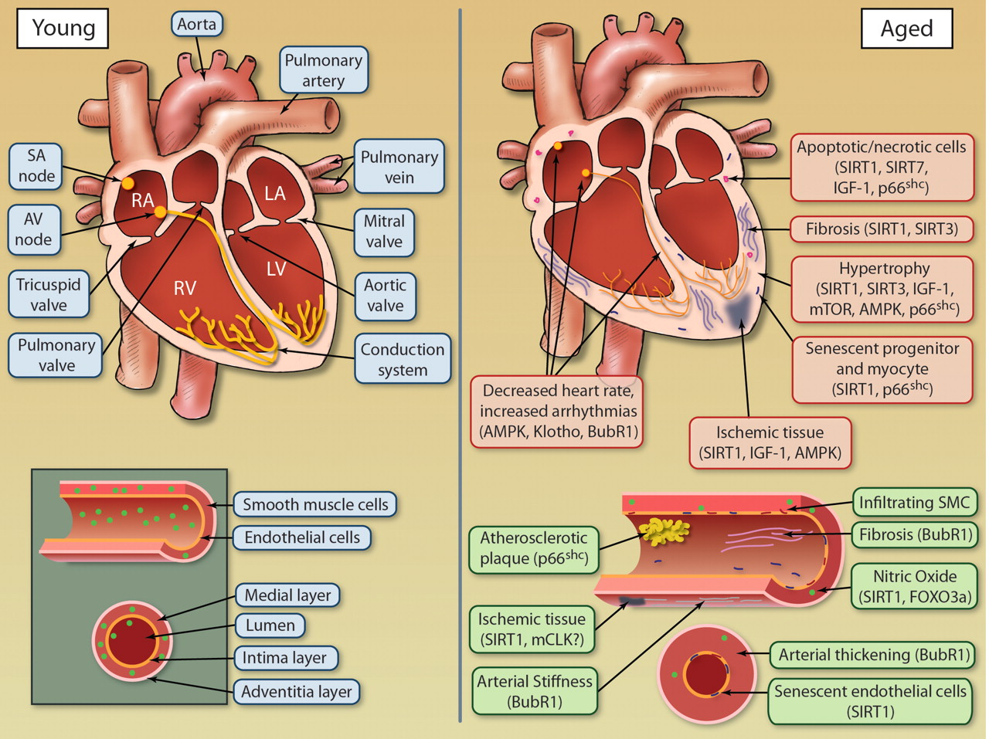
Notes:
Age-dependent changes to cardiovascular tissues. Both the heart and vasculature undergo numerous alterations during aging as a result of deregulation of molecular longevity pathways, leading to compromised function. Illustration credit: Cosmocyte/Ben Smith.
Measuring the Impact of Aging on the Heart and Vasculature
Aging is associated with a progressive decline in numerous physiological processes, leading to an increased risk of health complications and disease. By delivering oxygenated blood to all tissues in the body, the health of the cardiovascular system is vital for health of every tissue and longevity of the organism as a whole. Aging has a remarkable effect on the heart and arterial system, leading to an increase in CVD including atherosclerosis, hypertension, myocardial infarction, and stroke.³ Aging cardiovascular tissues are exemplified by pathological alterations including hypertrophy, altered left ventricular (LV) diastolic function, and diminished LV systolic reverse capacity, increased arterial stiffness, and impaired endothelial function^{3,4} (Figure 1). However, the health of the arterial and cardiac systems is not mutually exclusive, as each system greatly affects the other. For instance, an increase in arterial stiffness leads to compensatory mechanisms by the myocardium including LV hypertrophy and fibroblast proliferation, resulting in decreased cardiac output and increase in fibrotic tissue.^{3,4} Heart rate modulation is also affected by age with a decrease in both rate variability and maximum heart rate.⁵ Heart rate is influenced not only by the loss of cells in the sinoatrial node (responsible for controlling heart rate) but also by structural changes in the heart, including fibrosis and hypertrophy, which slow propagation of electric impulse throughout the heart.

Slide 11
Relationship of cardiovascular aging in healthy humans to cardiovascular disease
Age-associated changes | Plausible mechanisms | Possible relationship to disease
CV structural remodeling : Vascular intimal thicknes : Vascular stiffness : LV wall thickness : L. atrial size | : VSMC migration and matrix production Elastin fragmentation : Elastase activity : Collagen production and cross-linking Altered growth factor regulation and tissue repair : LV myocyte size ; Myocyte number Focal collagen deposition : L. atrial volume/pressure | Early stages of atherosclerosis Systolic hypertension Atherosclerosis ; Early LV diastolic filling : LV filling pressure/dyspnea : Risk of atrial fibrillation
Notes:
bAR beta-adrenergic receptor, CV cardiovascular, LV left ventricular, NO nitric oxide, VSMC vascular smooth muscle cell.

Slide 12
Relationship of cardiovascular aging in healthy humans to cardiovascular disease
Age-associated changes | Plausible mechanisms | Possible relationship to disease
CV functional changes Altered vascular tone ; CV reserve ; Physical activity | ; NO production/effects ; bAR responses : Vascular load ; Intrinsic myocardial contractility ; b-adrenergic modulation of heart rate, LV contractility and vascular tone Comorbidities ; Skeletal muscle mass | Vascular stiffening/hypertension Lower threshold for heart failure Accelerated aging changes in CV structure and function : Risk of CV disease
Notes:
bAR beta-adrenergic receptor, CV cardiovascular, LV left ventricular, NO nitric oxide, VSMC vascular smooth muscle cell.

Slide 13
Aging Research Leads to a New View of CVD
In both the aging and cardiovascular fields, it is generally accepted that a low calorie diet combined with exercise will increase the health span of mammals and that adiposity and a sedentary lifestyle have the opposite effect.
The traditional view is that CVD results from the accumulation of cholesterol and fatty acids in tissues, which compromise tissue function and stimulate the production of inflammatory cytokines as well as ROS.
In the past decade, however, the aging field has proposed that there is another fundamental process at work: a diet high in calories without exercise may be harmful because it suppresses the expression of “longevity genes” that promote cellular defenses against aging and age-related diseases.

Slide 15
Aging Research Leads to a New View of CVD
Data from human studies indicate that Okinawans eat a moderately restricted diet (≈1785 kcal/d) and have lower rates of coronary heart disease and a relatively high frequency of centenarians. Consistent with this, individuals on CR diets (0.5–8 years) have a physiology consistent with protection from CVD, including reduced triglycerides, lower blood pressure, reduced inflammatory markers, and decreased oxidative stress.
Many of the fundamental molecular processes involved in CR-mediated protection of the cardiovascular system are known.

Slide 16
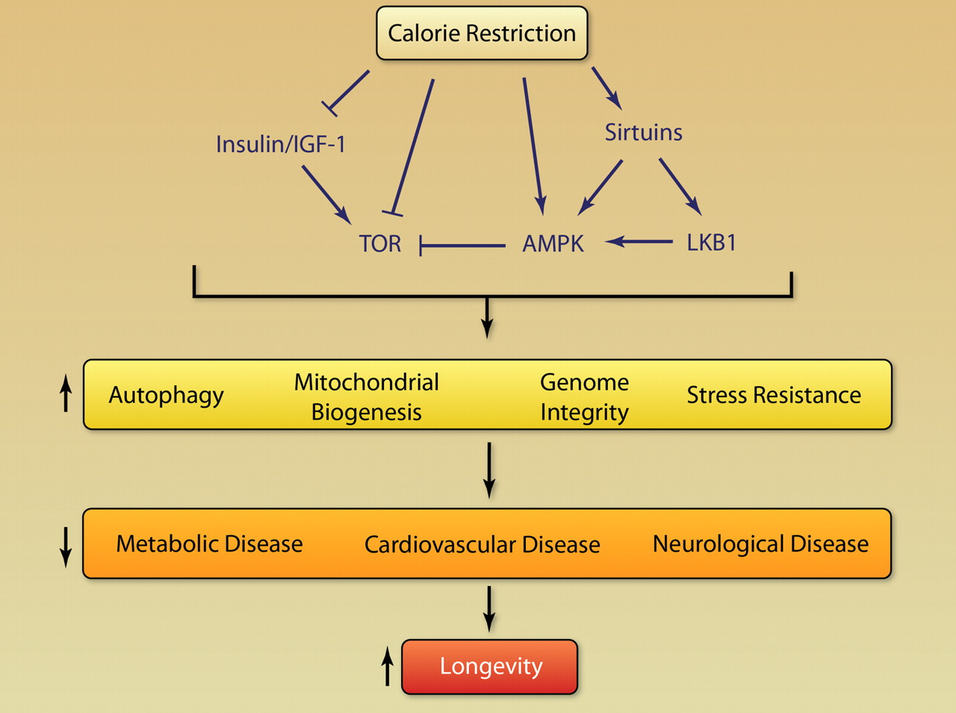
Notes:
Pathway leading from calorie restriction to longevity. Calorie restriction modulates factors in the longevity network, leading to alterations in cellular responses to stress, affecting common diseases of aging and influencing longevity.
Considerable progress has been made in the past decade toward understanding not only how but also why CR works. The original idea that CR works passively by suppressing metabolic rate or reducing damage caused by ROS is being replaced by a fundamentally different model in which CR triggers an active defense response that evolved to promote survival during harsh conditions. At the center of this response are so-called “longevity regulatory” pathways, which include insulin/insulin-like growth factor 1 (IGF-1), the mammalian target of rapamycin (mTOR), AMP-activated kinase (AMPK), and nicotinamide adenine dinucleotide (NAD)+-dependent deacetylases (sirtuins). Although researchers still argue about which longevity gene is most important for the health benefits of CR, the emerging picture is that these genes form a network of redundant pathways and both positive and negative feedbacks. How these pathways improve health and control one another is the most intense area of research at present in the aging field.

Slide 17
Longevity Genes and CVD
SIR2
Sirtuins are evolutionary conserved enzymes that function as NAD+-dependent deacetylases and ribosyltransferases. Mammals have 7 sirtuin members, which have diverse localizations in the cell and regulate a variety of cellular functions including DNA damage repair, cell cycle, metabolic response to nutrient availability, and protection from neurological degeneration. Numerous studies have maintained sirtuins as a key component of the longevity network.
Interestingly, SIRT1 is involved in both pressure overload-induced, and Angiotensin II, cardiac hypertrophy in addition to hypertrophy of vascular smooth muscle.
Arterial stiffness is also regulated by SIRT1 through preventing hyperphosphatemia-induced arterial calcification.

Slide 18
Longevity Genes and CVD
IGF-1/Growth Hormone
IGF-1 was one of the initial genes to be identified as a longevity gene, where loss of IGF-1 was shown to extend lifespan of C elegans. Subsequently, genes involved in the IGF-1 pathway were characterized to modulate lifespan as well, confirming the role of this pathway in lifespan regulation. IGF-1 signaling modulates other factors in the longevity network by inducing mTOR activity through regulation of Akt activity.
Overexpression of IGF-1 in the heart prevented myocardial cell death after infarction and reduced ventricular dilation, hypertrophy, and diabetic cardiomyopathy. However, in a second overexpression study, IGF-1 led to cardiac hypertrophy and failure as well as to diminished recovery of heart function after acute ischemic challenge.

Slide 19
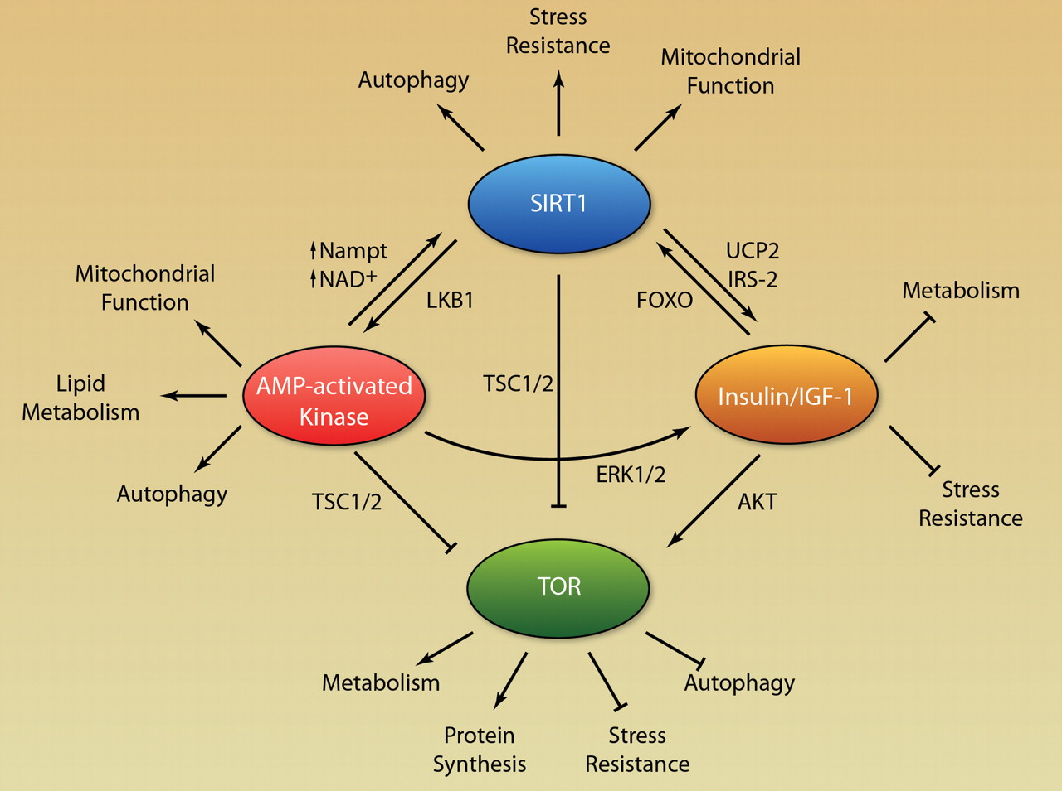
Notes:
Model for a longevity network. Positive and negative feedback regulation between genes involved in lifespan and age-related diseases including sirtuins, AMPK, IGF-1, and TOR.

Slide 20
Longevity Genes and CVD
Forkhead Transcription Factors
Forkhead transcription factors (FOXOs) play a role in regulating expression of genes involved in cell growth, proliferation, differentiation, and longevity. FOXOs are also downstream effectors of the IGF-1 signaling cascade and are regulated by sirtuin-mediated deacetylation.
Expression of FOXO3a in mouse hearts resulted in reduction of cardiomyocyte size, suggesting that this FOXO factor functions to reduce hypertrophy FOXO3a deficiency has been shown to increase eNOS expression and enhances postnatal vessel formation and maturation.

Slide 21
Longevity Genes and CVD
Clock 1
Clock 1 (CLK-1)/mammalian CLK-1 (MCLK1) is a hydroxylase localized to the mitochondria that is necessary for the biosynthesis of ubiquinone (coenzyme Q), the essential electron transporter of the mitochondrial respiratory chain. Inactivation of clk-1 in C elegans and partial inactivation in mice extends lifespan of both organisms.
MCLK-1 heterozygous mice have yet to be assessed for effects on cardiovascular system function and disease progression. However, these mice are known to exhibit protection from cerebral ischemia and reperfusion, suggesting a potential role in modulation of vascular response to ischemic conditions.
BubR1
BubR1 is a serine/threonine protein kinase and an inhibitor of the anaphase-promoting complex, regulating the mitotic spindle assembly checkpoint.

Slide 22
Longevity Genes and CVD
AMPK
The AMP-activated protein kinase is involved in glucose and lipid metabolism, cell growth and autophagy, cellular polarity, and gene expression.
P66shc
In the cardiovascular system, loss of p66shc blocks the decline in cardiac progenitor cell senescence, decreases DNA damage, necrosis, and apoptosis, and preserves LV volume and function, thus reducing heart failure. Loss of p66shc also prevented Angiotensin II–induced hypertrophy and apoptotic cell death.
Catalase
Catalase converts one of the major ROS, hydrogen peroxide, into water and oxygen. Similar to p66shc knockouts, mitochondrial-targeted catalase mice emphasize the role of ROS in CVD.

Slide 23
Longevity Genes and CVD
Pituitary Transcription Factor 1 and Prophet of Pituitary Transcription Factor 1
The pituitary transcription factor 1 (Pit-1) is involved in the transcriptional program for normal development and function of the pituitary gland.
Klotho
Klotho was discovered as a gene that is mutated in a mouse strain presenting multiple premature aging phenotypes and a shortened lifespan. In addition, overexpression of Klotho increases lifespan.
Target of Rapamycin/Rapamycin
Target of rapamycin (TOR), is a serine-threonine protein kinase that is inhibited by the bacterial product rapamycin. The PI3K/AKT/mTOR pathway lies at the intersections of numerous signaling pathways, thus positioning this pathway as a vital mediator of aging and the cardiovascular system.

Slide 24
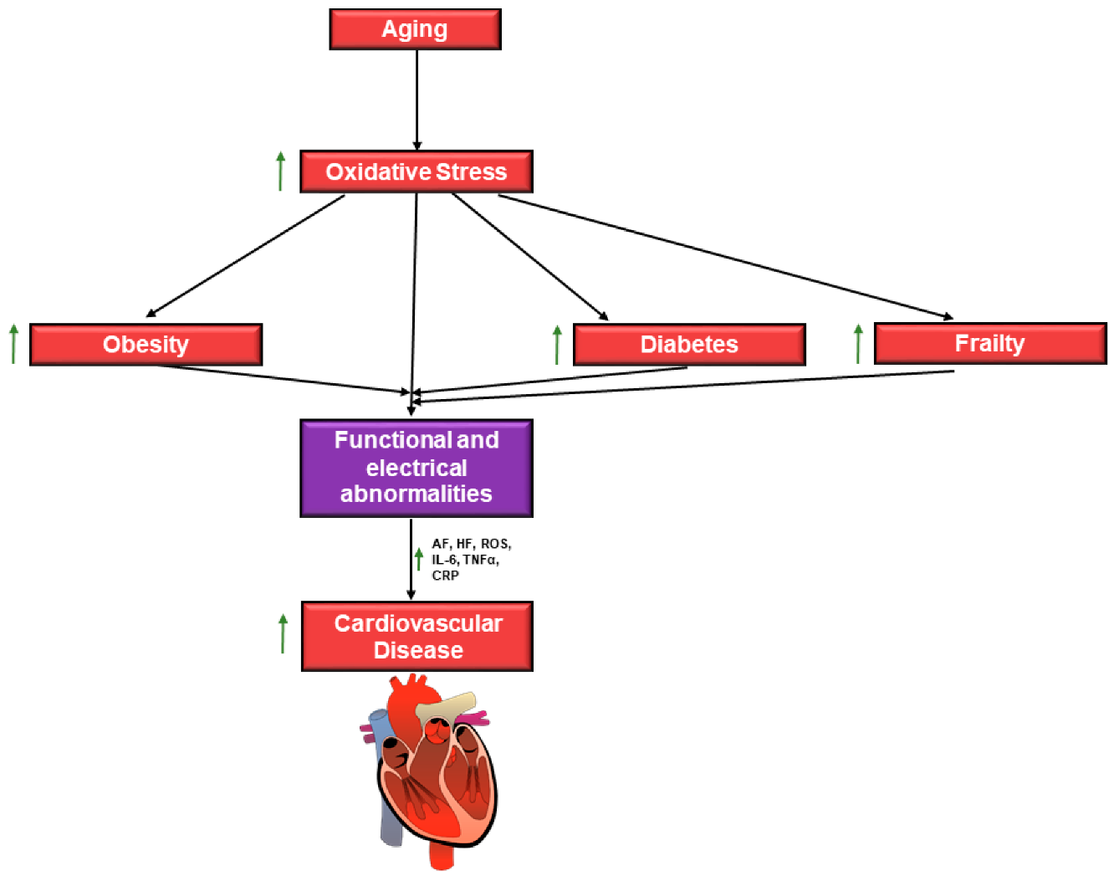
Notes:
Schematic diagram of age-related risk factors for cardiovascular disease (CVD). Age is associated with increased oxidative stress, which leads to an increased susceptibility for functional and electrical abnormalities which lead to CVD. These abnormalities include atrial fibrillation (AF) and
heart failure (HF), which are a result of increased reactive oxygen species (ROS) due to oxidative stress and increase production of inflammatory signal molecules. Age is also associated with an increased risk for frailty, obesity, and diabetes. These conditions are also independent risk factors for CVD. Multiple risk factors result in a high incidence of CVD in aging adults.

Slide 25
Heart valve disease in elderly
Progressive ageing of a population is associated with an increased prevalence of chronic degenerative diseases. Among these, heart valve abnormalities represent an important public-health problem leading to high morbidity and mortality.
Degenerative process was the main cause of aortic involvement and mitral regurgitation (MR). Mitral stenosis (MS) was mainly due to rheumatic disease. Incidence of valvular disease increased with age. Incidence of VHD was 6% for both mitral and aortic disease in patients aged ≥ 75 years, while in younger patients (aged < 64 years), the incidence was less than 1%.
MR was the most frequent VHD in elderly patients (9.3%) followed by AS (2.8%), aortic regurgitation (AR) (2.0%), and finally MS (0.2%).

Slide 28
AORTIC VALVE
AS
In the elderly, degenerative AS is one of the most common types of valvular heart disease. The prevalence of AS has been reported to be between 12% and 26% depending on the diagnostic criteria employed.
Overall, 40% of patients with severe AS were considered to be at high surgical risk.
Calcific aortic valve disease evolves over the years at a different rate in every subject.
Several studies suggested that calcific degenerative AS and atherosclerosis have common risk factors such as age, smoking, hypertension, hypercholesterolemia, diabetes mellitus, and metabolic syndrome.

Slide 29
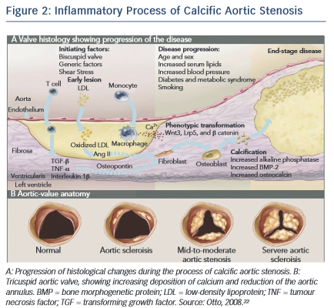

Slide 30
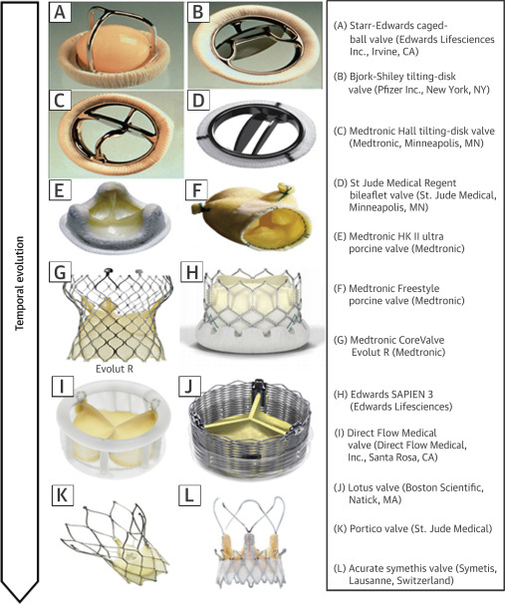

Slide 31
AORTIC VALVE
AR
Epidemiology and pathophysiology: Isolated AR is significantly less common than pure AS.
Degenerative and bicuspid aortic valve disease shows a different degree of both regurgitation and left ventricular obstruction; however, stenosis is usually pre-eminent.
More frequently, AR is a consequence of aortic dilation and the deformation of the annulus valve. Overall prevalence of significant native AR has been reported in between 2.0% and 2.5% of patients 70 years to 83 years of age, without gender differences although smaller studies reported a higher incidence of up to 13%.
Age, aortic valve fibrocalcification, and female sex were considered independent factors related to AR, while several studies failed to find a relationship with arterial hypertension.

Slide 32
MITRAL VALVE
Several conditions may damage the MV in older patients, such as degeneration of valve leaflets, calcification of the mitral annulus commonly involving the posterior leaflet, ischemia, and rheumatic heart disease.
Anatomo-functional abnormalities of the MV apparatus may result in valve stenosis or, more frequently, regurgitation.
The most common etiology of MS is rheumatic heart disease; however, it is not common that the disease remains undiagnosed up until an advanced age.
Functional MS related to massive annular calcification and reduced leaflet excursion has been reported in 2.5% to 18.0% of elderly patients.
Degenerative MS accounted for 12.5% of MS cases according to data of the Euro Heart Survey. The severity of calcification has significant implications for surgery.

Slide 34
MITRAL VALVE
In industrialized countries, MR is the most frequent valvular heart disease in patients over the age of 65 years.
Elderly patients account for about 40% of all patients with MR and 4.5% are over 80 years of age.
Heart failure, arrhythmia, and death may occur in patients with severe disease. Prevalence of moderate MR in the Framingham study was 11.1% in men 70 years to 83 years of age.
In the study, no information was reported regarding valve morphology. Secondary MR has been reported in about 25% of patients after myocardial infarction and in more than 50% in heart failure with depressed ejection fraction.

Slide 36
TRICUSPID VALVE
Tricuspid regurgitation (TR) is the second most common VHD after MR with an incidence of 1.2% to 1.5% in the general population.
The prevalence increases with age and in particular in females. In the group of 70 to 83 year-olds, incidence is 5.6% in women as compared to 1.5% in men. Severe TR is associated with higher 1-year mortality and poorer outcomes independent of age and other comorbid conditions.
In elderly subjects, functional or secondary TR due to left heart disease, often MR or AS, is by far the more common etiology of TR. TR secondary to left heart valve disease is often associated with poor prognosis and difficult therapeutic choices. Pulmonary hypertension, right ventricular infarction, chronic right ventricular pacing, and history of AF are other common causes of secondary TR.

Slide 37
Coronary heart disease in the elderly

Slide 39
Coronary heart disease in the elderly
The clinical manifestations of CHD in older patients represent the effects of the disease superimposed on the physiological effects of age. The presence of obstructive coronary artery disease at autopsy approaches 50% in elderly women and 70% to 80% in elderly men.
Although octogenarians comprise 5% of the US population, they represent 20% of all hospitalizations for myocardial infarction (MI) and 30% of all MI-related hospital deaths. At coronary arteriography, elderly individuals have more extensive coronary artery disease, more multivessel disease, more coronary artery calcification, and are more likely to have had a prior MI.

Slide 40
Coronary heart disease in the elderly
Whereas typical angina pectoris remains common at elderly age, an increased percentage of older versus younger patients have atypical manifestations of myocardial ischemia, including dyspnea and worsening heart failure, in addition to an excess occurrence of unstable angina and non–Q-wave MI.
Reductions in physical activity and aerobic exercise capacity often seen with “normative” aging also affect the older CHD patient. The frequent coexistence of chronic lung disease, peripheral arterial disease, arthritis, and neuromuscular disorders may make ambulation difficult. A lack of anginal symptoms in an elderly patient with suspected CHD may merely reflect the patient’s lack of significant activity.

Slide 41
Acute coronary syndrome in the older adults
Acute coronary syndrome (ACS) is the number one cause of mortality in patients older than 65 years old. To complicate this fact further, they also present atypically with weakness, nausea/vomiting, fatigue, and shortness of breath. It has been shown that older adults who present to the emergency department (ED) with ACS and a chief complaint other than chest pain have worse outcomes:
Higher in-hospital mortality
Misdiagnosed
Undertreated
If this does not concern you enough as an ED physician, then just know that the risk of death continues 30 days to one year after hospitalization with mortality rates of 15% for adults aged 75 to 85 years and 25% for adults older than 85 years.

Slide 42
Clinical information critical to diagnosis and management of ACS in the older adults
Clinical symptoms for ACS diagnosis
Typical symptoms (less predictive for ACS in elderly)
Atypical symptoms (more common in elderly)
Non-CV acute disease presentation (tachycardia, hypoxia, anemia, hypotension)
Autonomic symptoms (more common in elderly)
Altered mental status (more common in elderly)
Exertion-induced symptoms (less common in elderly)
Hemodynamic stressor-induced symptoms (more common in elderly)

Slide 43
Clinical information critical to diagnosis and management of ACS in the older adults
History relevant to ACS management
Prior MI and intervention history
Baseline functional and mental status
Baseline quality of life/preferences
Expected life expectancy/advanced directive
Comorbid conditions (indication for multiple anticoagulants)
Frailty/fall risk
Bleeding risk

Slide 44
Clinical information critical to diagnosis and management of ACS in the older adults
Physical signs relevant to ACS management
Mental status
Hemodynamic stability
Murmurs
Signs of decompensated heart failure
Peripheral vascular conditions
Significant degenerative conditions (scoliosis suggestive for aortic tortuosity, etc)

Slide 45
Clinical information critical to diagnosis and management of ACS in the older adults
Laboratory tests
Renal function (creatinine clearance calculation)
Baseline hemoglobin
Cardiac biomarkers
Baseline endocrine insufficiency
Electrolytes derangement

Slide 46
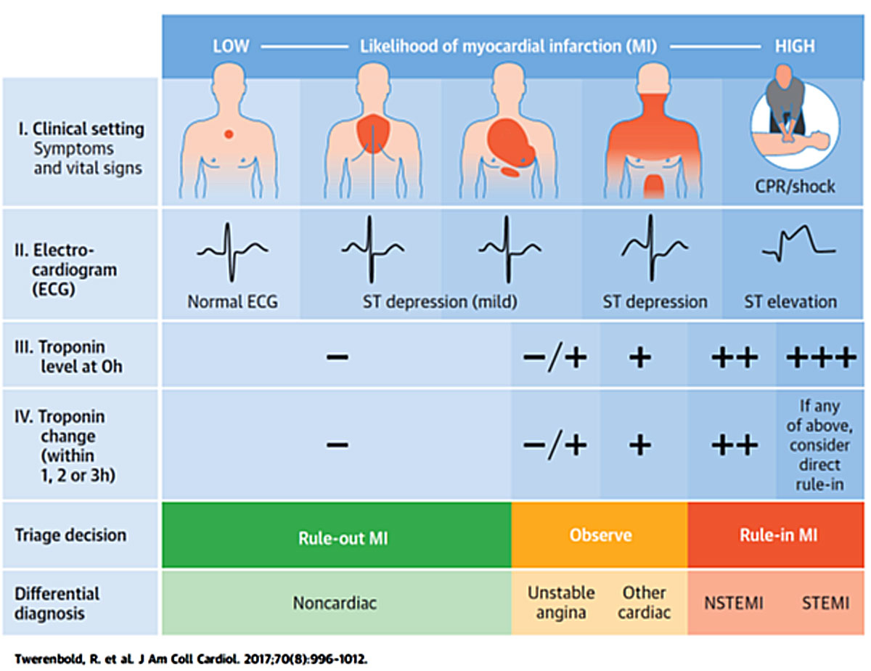

Slide 47
Pharmacotherapy for ACS in older adults
UFH | Beneficial: may add GPI with PCI
Enoxaparin | May be used prior to PCI; no bolus with reduced dosage for ≥ 75 years of age; increased bleeding risk
Fondaparinux | Not recommended as sole anticoagulant for PCI due to catheter thrombosis; increased bleeding risk in elderly
Bivalirudin | Mono-agent for PCI has comparable efficacy as UFH+GPI, but reduces bleeding risk than UFH+GPI in elderly ACS
Factor Xa inhibitors | Rivaroxaban and Apixaban (only rivaroxaban approved for secondary prevention)

Slide 48
Pharmacotherapy for ACS in older adults
Fibrinolytics | Only for STEMI when expected to delay > 120 min from FMC to FDA; advanced age increases risk of intracranial hemorrhage; half-dose for ≥ 75 year-old; Fibrin-specific agents have lower risk of bleeding in elderly
Nitroglycerin | Ameliorates symptoms, reduces LV preload, increases coronary flow. Be cautious of hypotension
Beta-blockers | Oral beta-blockers benefit elderly more than younger adultsIV beta-blockers are harmful in ACS with HF presentation
ACEi/ARB | Beneficial with reduced EF – caution if CKD for creatinine and potassium level changes
Statins | Greater beneficial in elderly than younger adults, side-effects are more common as well, moderate intensity maybe as good as high intensity statin. Cautions are required – Guidelines now for moderate intensity statin age ≥ years
Notes:
ACEi: angiotensin converting enzyme inhibitors; ACS: acute coronary syndrome; ARB: angiotensin receptor blockers; CKD: chronic kidney disease; CVA: cerebrovascular accident; EF: ejection fraction; FDA: first device activation; FMC: first medical contact; GPI: glycoprotein IIb/IIIa inhibitors; LV: left ventricle; PCI: percutaneous coronary intervention; STEMI: segment elevation myocardial infarction; TIA: transient ischemic attack; UFH: unfractionated heparin.

Slide 49
What is the most common presenting symptom of older adults with ACS?
Chest pain (58 – 83.4%) — More common in men
Shortness of breath (23 – 65.3%)
Diaphoresis (4 – 56.8%)
Nausea (7 – 45.3%) — More common in women
What is the in-hospital mortality of older adults with ACS presenting with a chief complaint that is chest pain?
Mortality in women:
Age < 65 years = 3.7%
Age ≥ 65 years = 13%
Mortality in men:
Age <65 years = 2.4%
Age ≥ 65 years = 6.6%

Slide 50
What is the in-hospital mortality of older adults with ACS presenting with a chief complaint that is NOT chest pain?
Mortality in women:
Age < 65 years = 16.1%
Age ≥ 65 years = 21.2%
Mortality in men:
Age < 65 years = 12.5%
Age ≥ 65 years = 22%
How long do older adults with ACS wait before seeking care at the ED? 5
More than 50% of older adults wait 2 hours – 2.5 days before seeking care
Only 10 – 14% present to the ED within 1 hour of symptom onset

Slide 51
Myocardial Infarction
Contributions to increased MI mortality at an elderly age include an increased incidence of comorbid conditions, more extensive CHD, and a lesser use of beneficial therapies, including substantial underuse of medications shown to improve MI survival (eg, aspirin, β-blocking drugs, and angiotensin-converting enzyme [ACE] inhibitors).
Furthermore, in the Myocardial Infarction Triage and Intervention Registry, which compared patients >75 years of age to younger patients, the rates of coronary thrombolysis were 5% versus 39%, percutaneous transluminal coronary angioplasty (PTCA) 7% versus 29%, coronary artery bypass grafting (CABG) 5% versus 11%, and aspirin use 57% versus 82%.

Slide 52
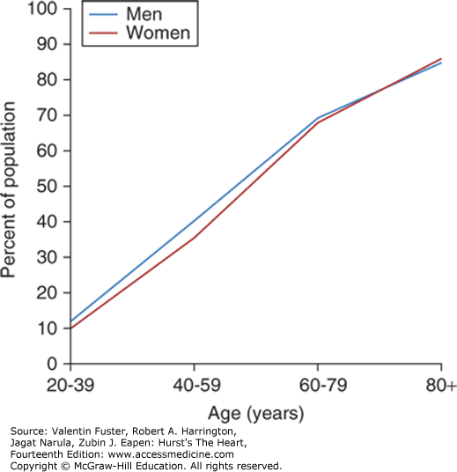
Myocardial Infarction

Slide 53
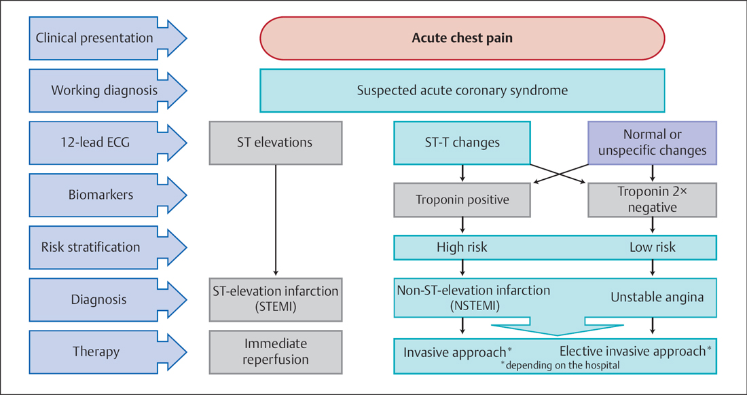

Slide 54
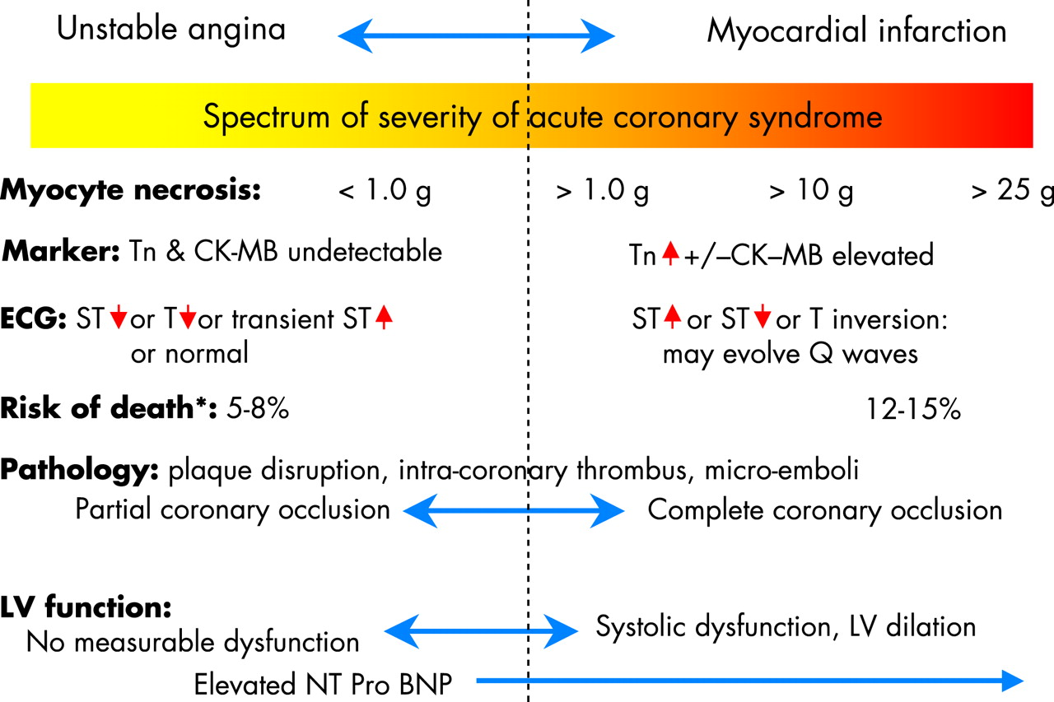

Slide 56
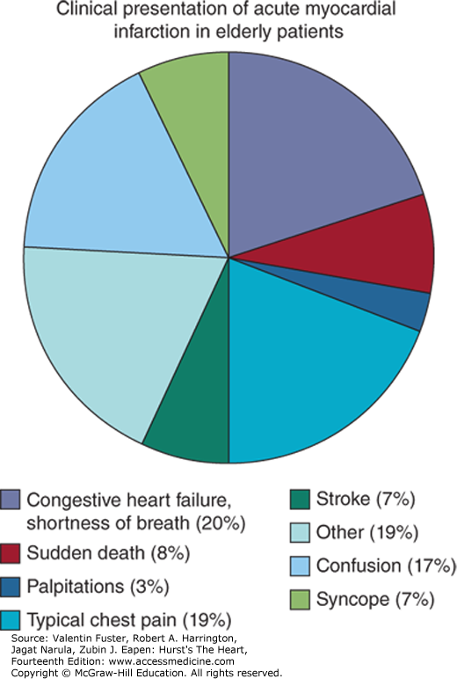

Slide 57
Interventional Therapy
Because many older patients tolerate antianginal therapy poorly, and because octogenarians with unstable angina treated medically have an event-free one-year survival rate of only 55% with a high rate of persistent symptoms and recurrent hospitalizations, major interest has focused on the value of interventional therapy.
Although angiographic success is comparable to that seen in younger patients, elderly patients who undergo PTCA are more likely to be women and to have multivessel high-grade stenoses and an excess of hospital death and postprocedural MI.
The newer transcatheter procedures, including intracoronary stenting, have shown similar success rates in patients ≥70 years of age compared with younger patients in the Newer Approaches To Coronary Interventions (NACI) Registry, although other studies have described an excess of non–Q-wave MI and vascular complications in this older patient group.

Slide 58
Arrhythmias
Frequency of complex cardiac arrhythmias, both atrial and ventricular, increases markedly with age in clinically healthy populations and may also be a sign of acute myocardial ischemia in the elderly.
Sudden death as the initial manifestation of CHD is more common in this age group. Atrial fibrillation affects ≈10% of individuals older than 80 years of age, with CHD, hypertension, and valvular disease the most common causes, often in association with HF.
The development of atrial fibrillation during an episode of myocardial ischemia often presents as acute HF, which may rapidly resolve with restoration of sinus rhythm.

Slide 59
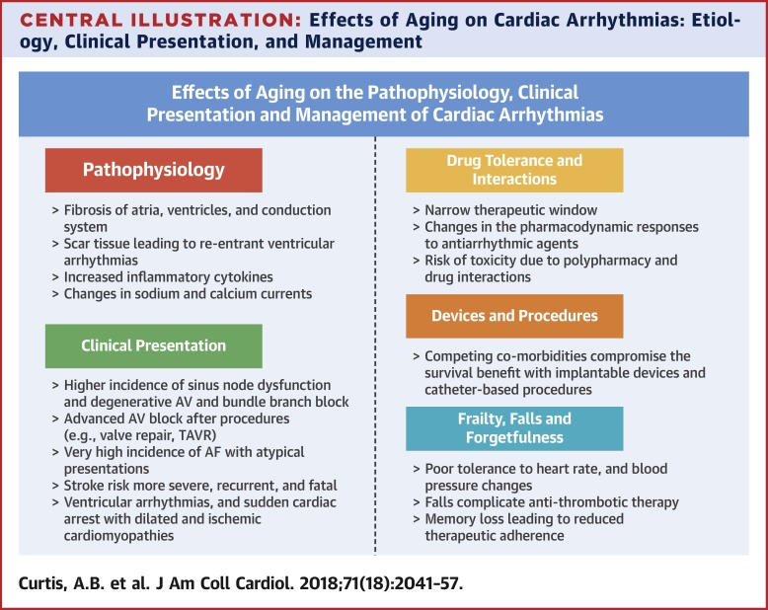

Slide 61
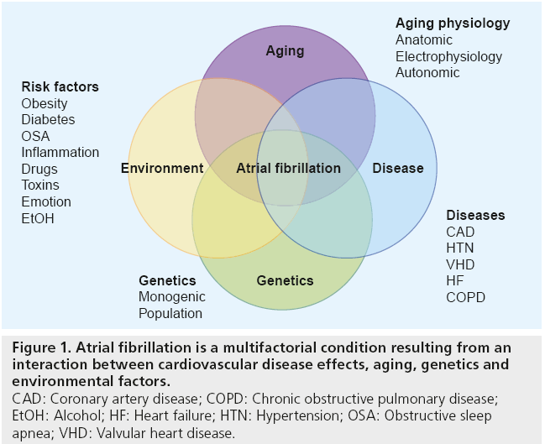

Slide 62
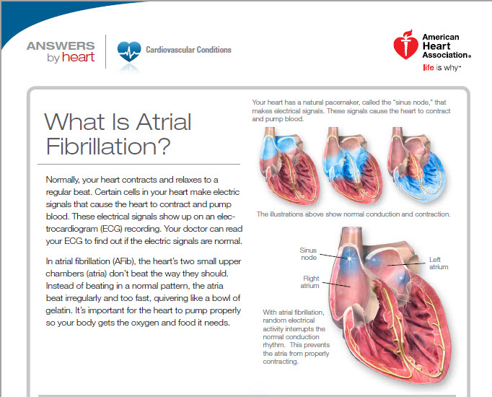

Slide 63
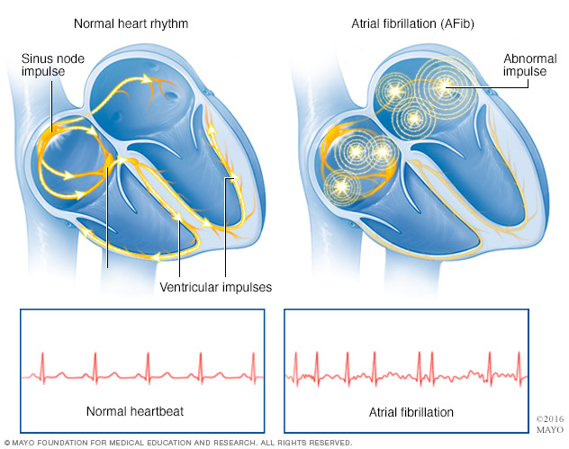

Slide 64
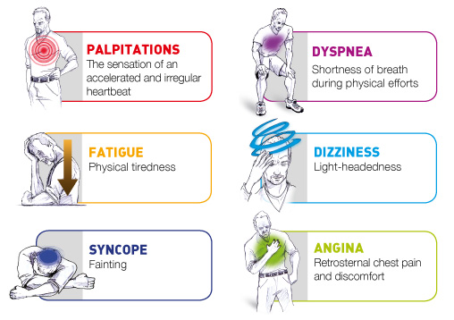

Slide 65
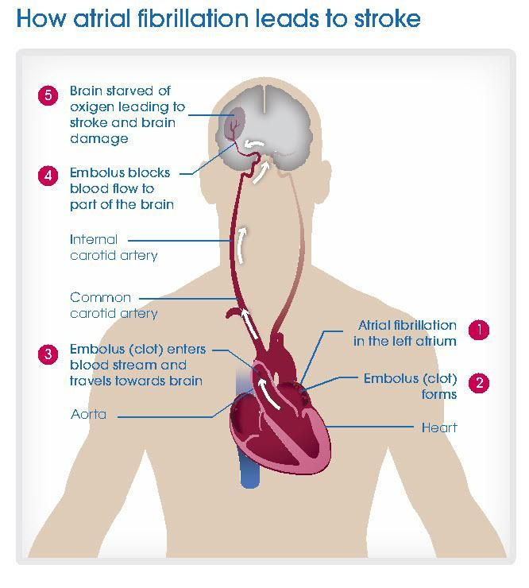

Slide 66
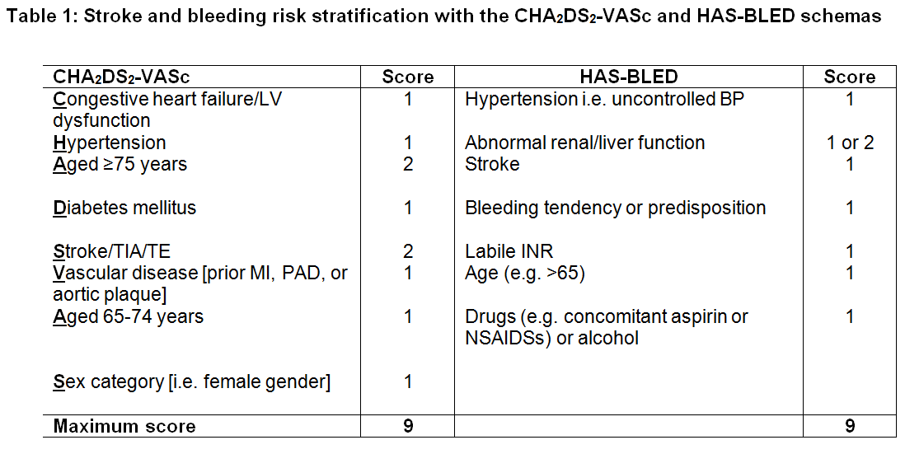

Slide 67
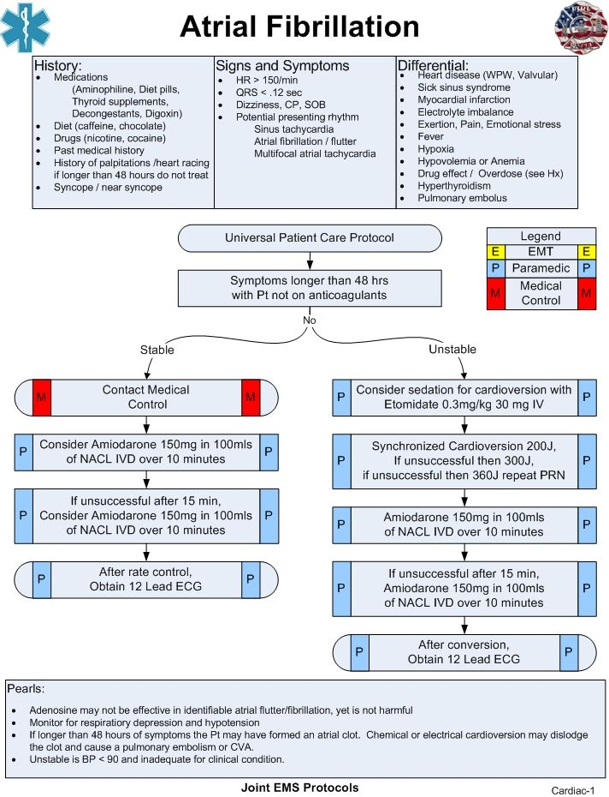

Slide 68
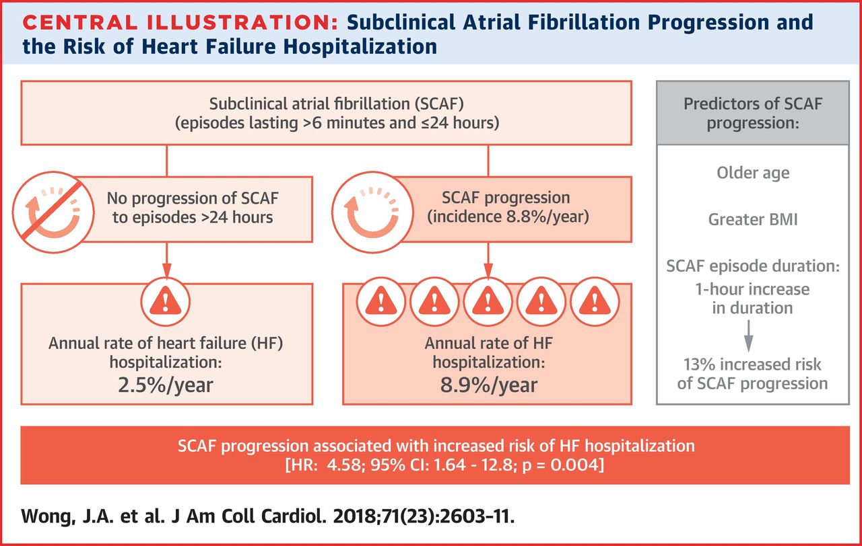

Slide 69
Hypertension
Hypertension is common among elderly patients of both sexes and is a major risk factor for CHD, cerebrovascular disease, and peripheral arterial disease.
It is the most common antecedent of HF and chronic renal failure. According to Joint National Commission (JNC) VI criteria, >50% of people over the age of 60 years, especially women, are hypertensive.
Treatment and control of hypertension are suboptimal in the elderly, inasmuch as nearly two thirds of those ≥75 years of age have uncontrolled hypertension, defined as systolic blood pressure ≥140 mm Hg and/or diastolic blood pressure ≥90 mm Hg.
Isolated systolic hypertension (systolic blood pressure ≥140 mm Hg with diastolic blood pressure <90 mm Hg) is the most common type of hypertension in the elderly, and a wide pulse pressure (≥50 mm Hg) in this age group may be a better marker for cerebrovascular disease and HF than mean or diastolic blood pressure.

Slide 70
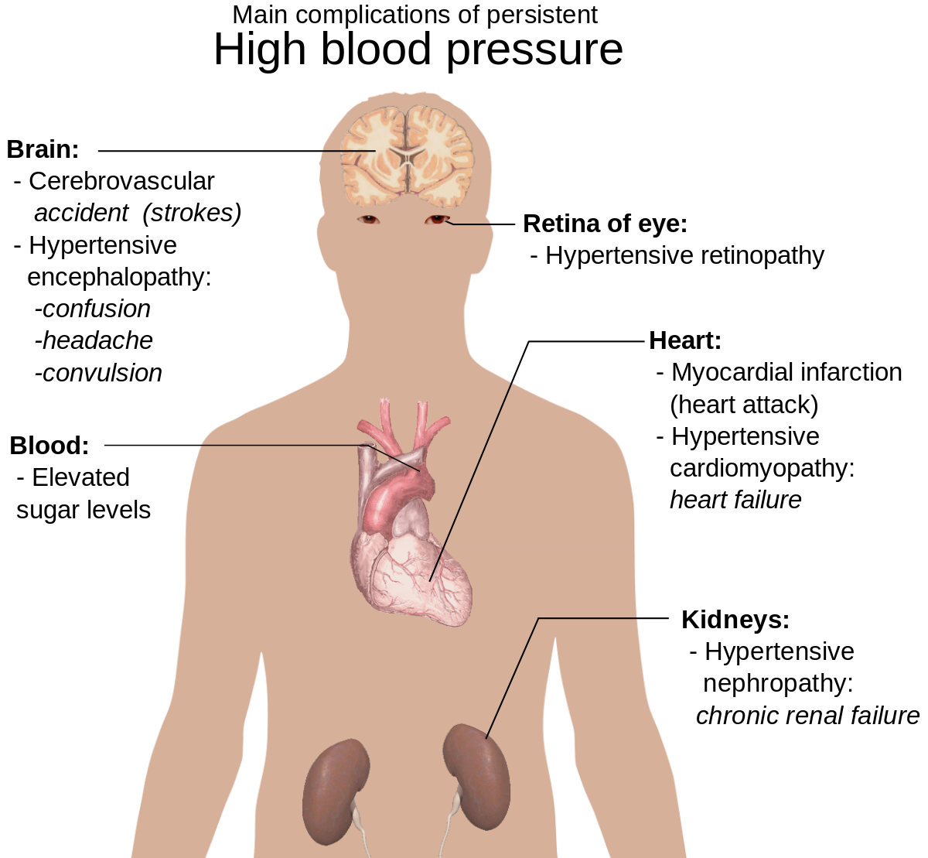

Slide 73
Hypertension
Treatment of hypertension in the elderly should follow the JNC VI guidelines.
Nonpharmacological therapy, a cornerstone of management, including weight reduction, decreased sodium and alcohol intake, and exercise, is more effective in older populations when compared with the younger age group.
Selection of pharmacological therapy should be based on the severity of hypertension, presence of risk factors, and target organ damage.
Selection of a specific drug therapy also depends on the presence of comorbidities, particularly HF and type 2 diabetes mellitus, for which ACE inhibitors are particularly appropriate.
Control of hypertension and, specifically, isolated systolic hypertension has been clearly associated with reduction in morbidity and mortality due to stroke, CHD, HF, and chronic renal failure.

Slide 81
Heart Failure in Elderly Patients
HF is predominantly a disease of the elderly. The mean age of HF patients is >70 years in most developed countries, and the prevalence of HF rises dramatically with age, from 1–2% among individuals aged 45–54 years to >10% among those aged ≥75 years.
Ageing predisposes to HF through multiple mechanisms. First, HF is a frequent outcome of virtually all cardiovascular diseases. Hence, patients with most cardiovascular diseases (i.e. hypertension, acute coronary syndromes, cardiac surgery, etc.) are prone to developing ventricular remodelling and HF when elderly.
Secondly, even in the absence of any cardiovascular event, ageing is associated with reduced aortic and left ventricular (LV) compliance, with increased aortic impedance and abnormal LV diastolic function. These conditions lower the threshold for the development of HF when the heart is exposed to precipitating factors such as hypertension and/or tachyarrhythmias (especially atrial fibrillation).

Slide 82
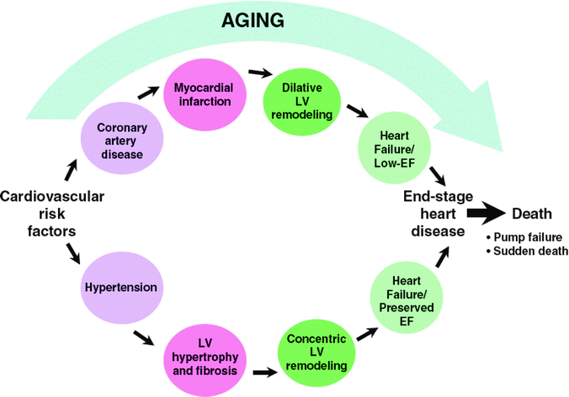

Slide 85
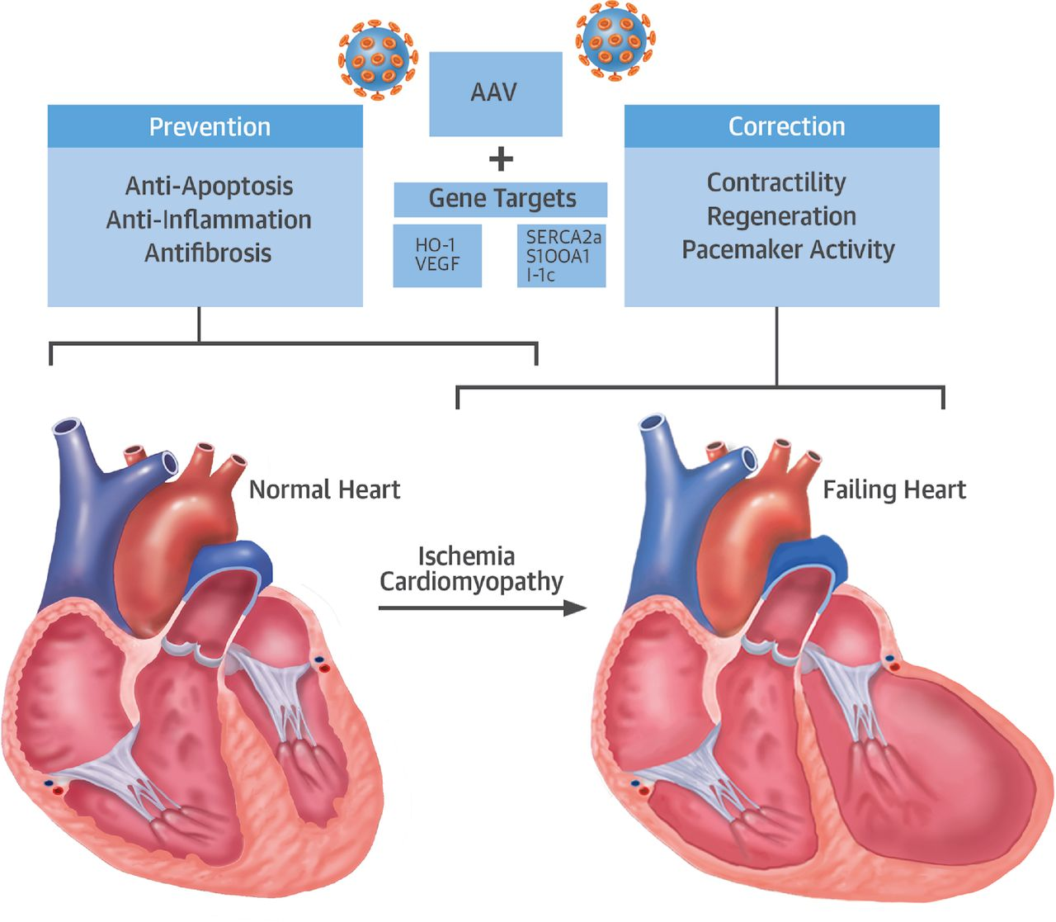

Slide 87
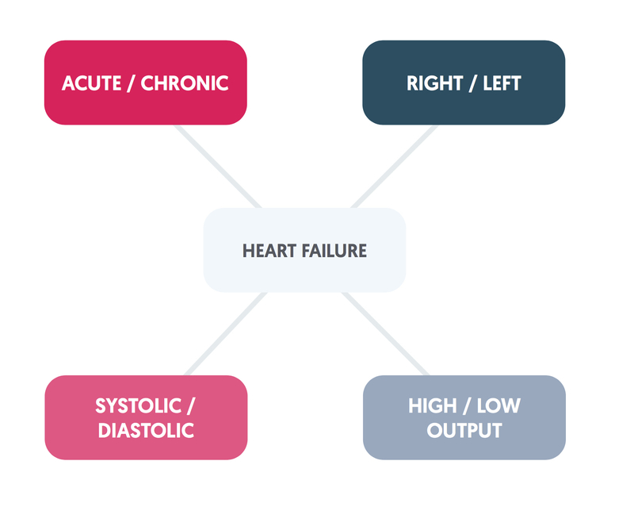

Slide 89
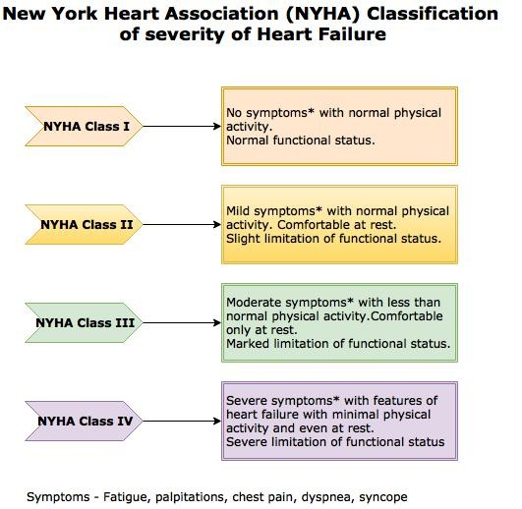

Slide 90
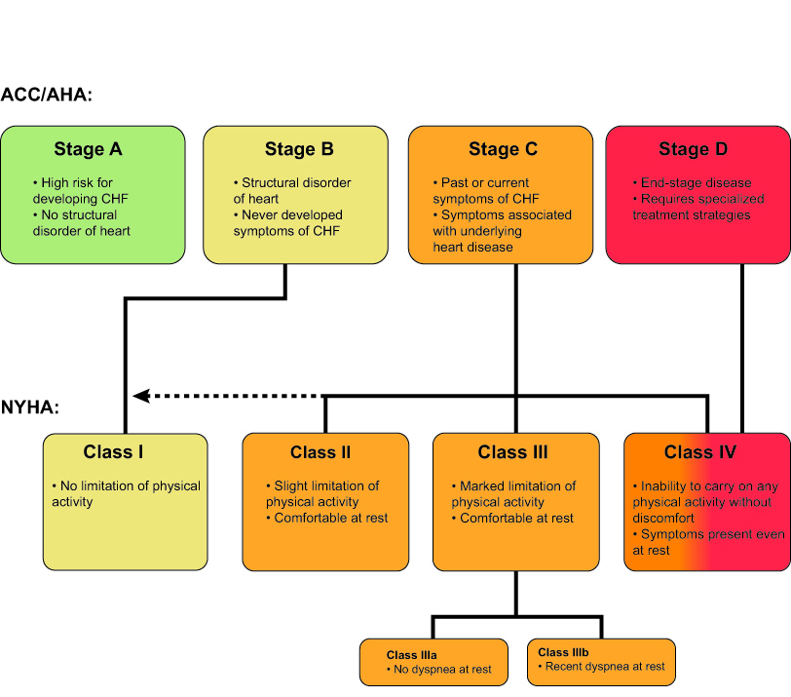

Slide 93
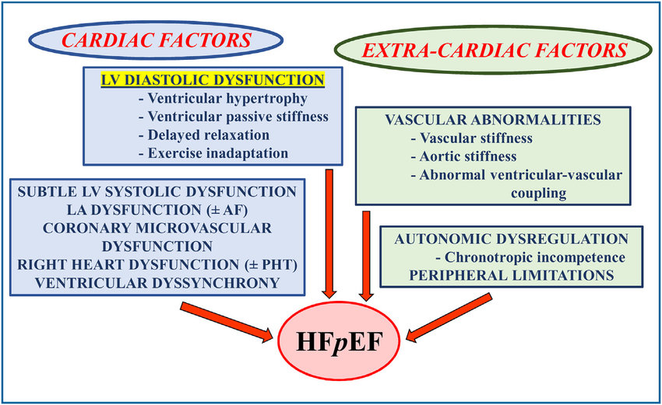

Slide 94
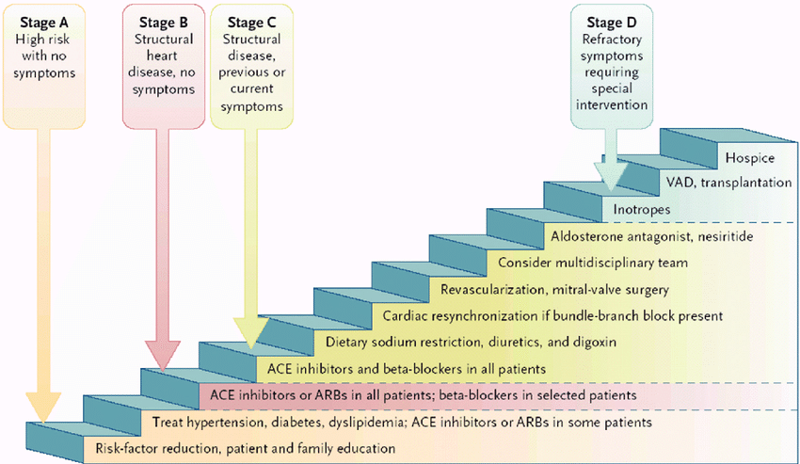

Slide 96
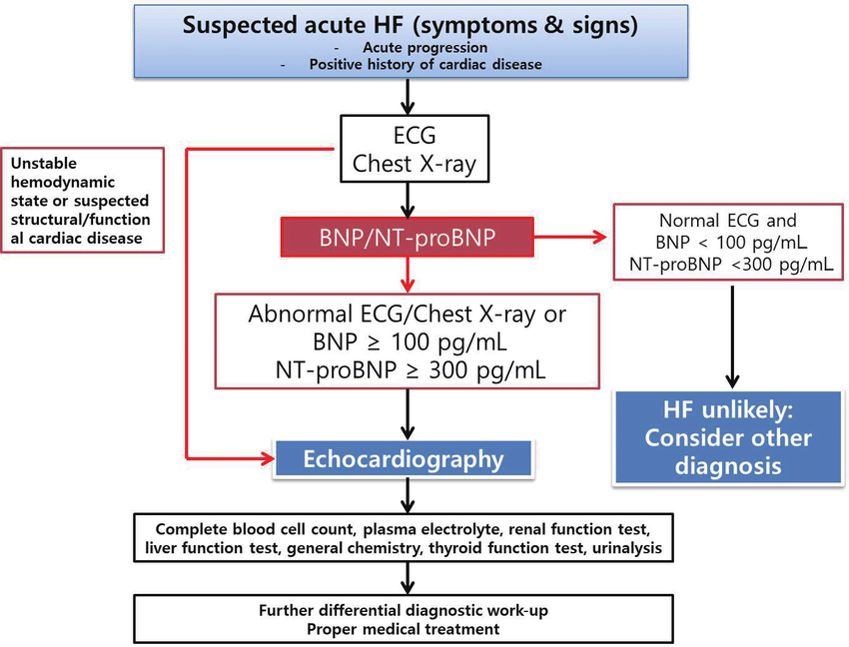

Slide 97
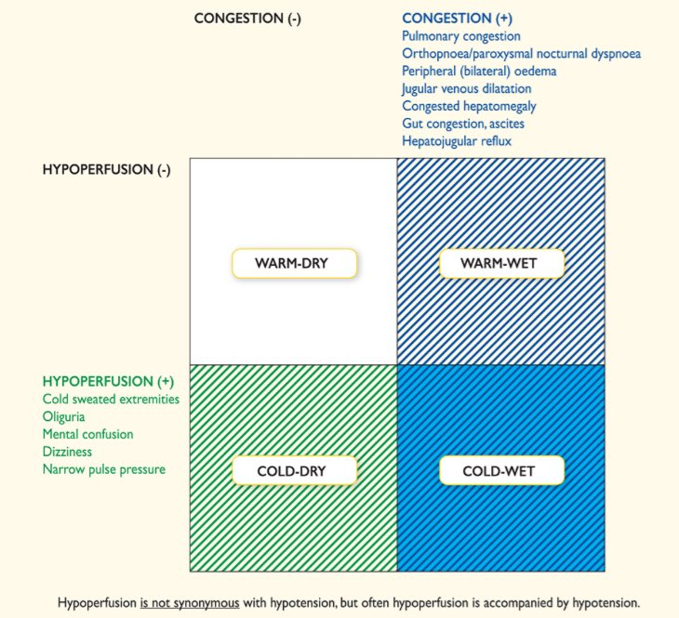

Slide 98
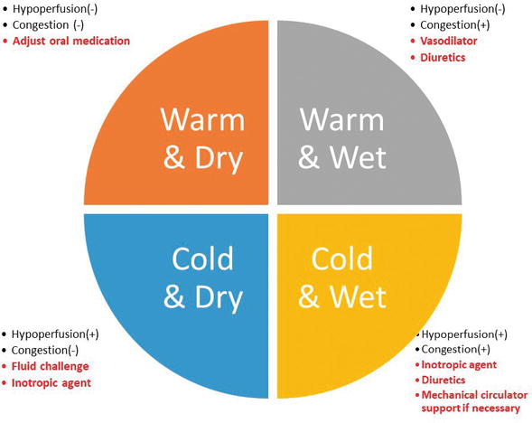

Slide 99
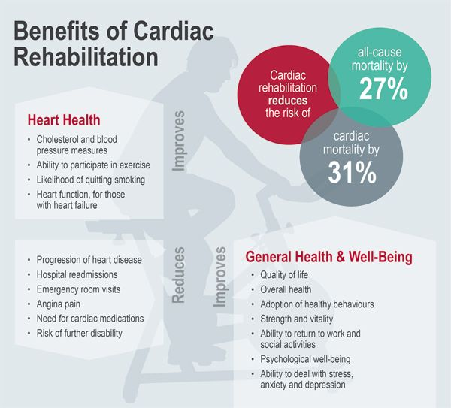

Slide 100
Thank you

